Slide 1


Abstra
Lazar Milicevic
Weekly support report
Support, Challenges, Solutions
14.10.2025

Slide 2
Agenda
1. Ticket & License Management
3. Visual & Helpdesk Improvements
5. Next Steps
2. Infra & Product Coordination
4. Historical Data Backfill
6. Q&A

Slide 3


Ticket & License Management
Customer success: Weekly Support Report – 14.10.2025
Where we are now ?
Rotated Zendesk on‑call schedule & triaged incoming tickets, ensuring SLA adherence.
Managed new Zendesk licenses for agents and external collaborators.
Created & refined ticket views and macros for efficient triage.
Handled Cursor & Abstra Access requests and delivered support documentation.

Slide 4
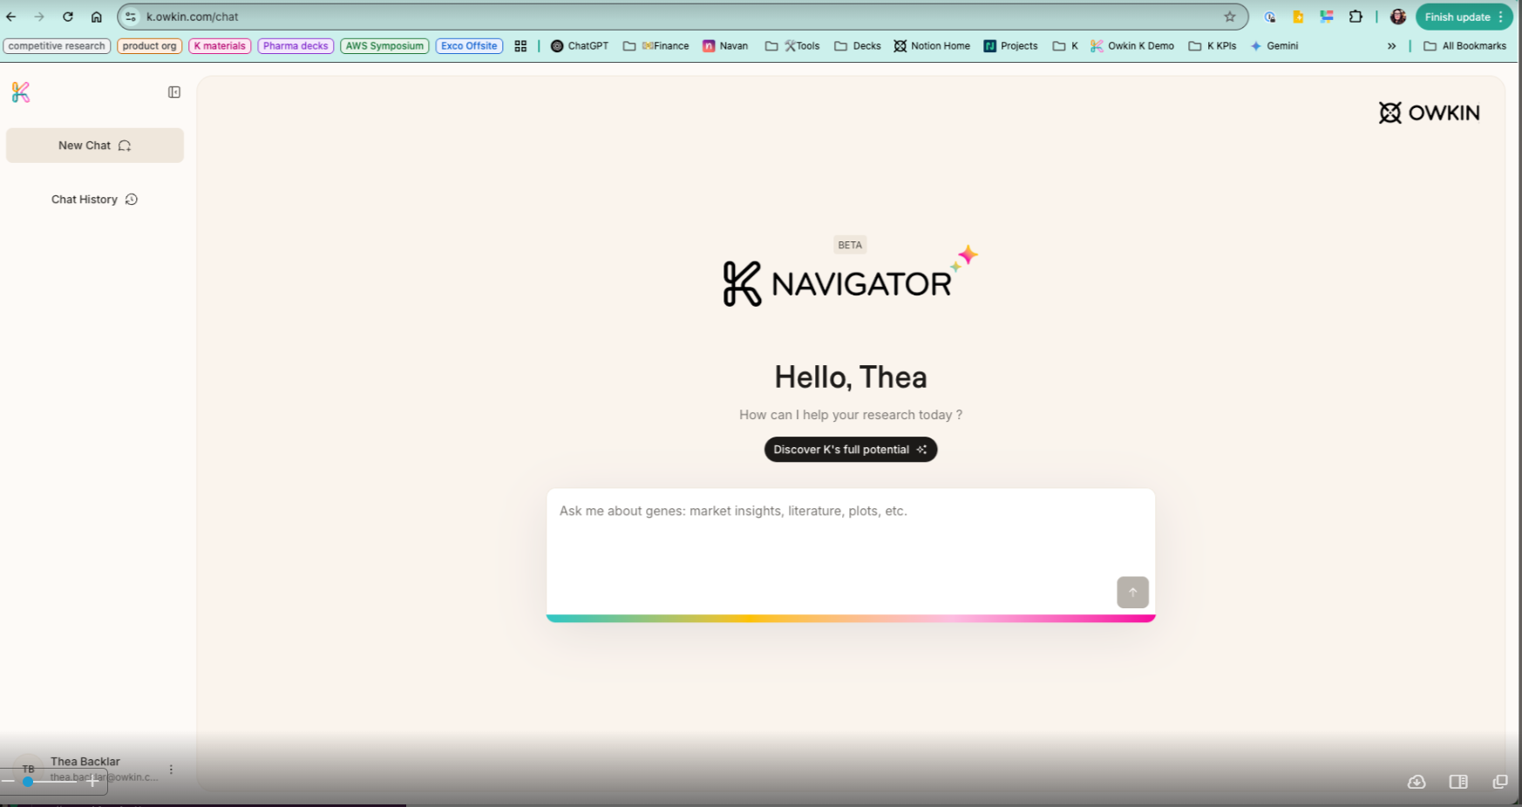
Infra & Product Coordination
Customer success: Weekly Support Report – 14.10.2025
Some of them:
Conducted multiple network troubleshooting sessions with end users to resolve connectivity issues.
Investigated & resolved access problems with Abstra (user provisioning & permissions).
Collaborated with Product & Infra teams to align onboarding logic and coordinate escalations.
Supported new user onboarding for Abstra (VPN setup, sign‑up flows etc..).

Slide 5
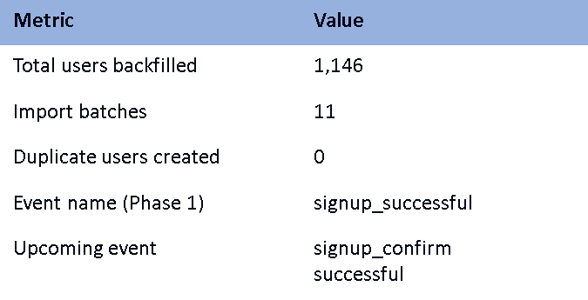
Historical Data Backfill
Customer success: Weekly Support Report – 14.10.2025
Cognito → PostHog
Objective: backfill historical sign‑up data from AWS Cognito into PostHog to consolidate analytics.
Built Python pipeline for export parsing, email→distinct_id mapping, JSONL generation & batch uploads with deduplication.
Full backfill completed: 1,146 users imported across 11 batches with zero duplicates.
Tested with custom events to ensure data integrity before production import.
Phase 3: using CloudTrail to extract confirmation timestamps for `signup_confirm_successful` event. – In progress

Slide 6
Next Steps
Customer success: Weekly Support Report – 14.10.2025
?
Extract and backfill `signup_confirm_successful` using CloudTrail logs.
Merge confirmation timestamps with existing dataset & update dashboards.
Finalize any remaining customer success remaining tasks

Slide 7

Q&A
Customer success: Weekly Support Report – 14.10.2025
?

Slide 8
Thank you!

